Slide 1


………………………….
Ahsan Kabir Project Manager

Slide 2
Day 1 Introduction
MSF Principle

Slide 3
“The Standish Group research shows 31.1% of projects will be cancelled before they ever get completed. Further results indicate 52.7% of projects will cost 189% of their original estimates.”
Problem Domain Research

Slide 4
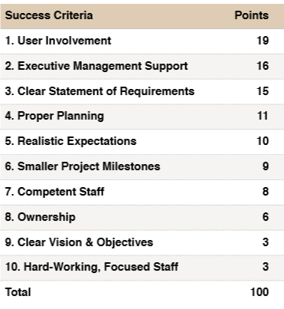
Solution Domain Research

Slide 5
“….is a approach for successfully delivering technology solutions faster, with fewer people and less risk, while enabling higher quality results” - MSDN

Slide 6

Principle
Governance
Team Model
Mindset
Microsoft Solution Framework

Slide 7
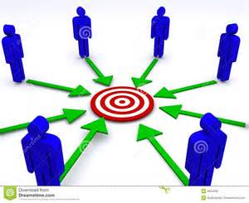
Shared Vision
“… empowers team members and enables agility “
“…. to make informed decisions quickly”
“… fill requirements gaps as they are discovered.”

Slide 8

“… share appropriate levels of information “
“… what needs to be done”
“… team members and external contacts communicate”
Communication

Slide 9

“… ways to survive in an ever-changing environment “
“... learn to creatively find ways to be successful “
Empower team members

Slide 10

“…team member accountability leads to higher quality.”
“…shares responsibility for the overall solution and
its deliverables”
Accountability and shared responsibility

Slide 11
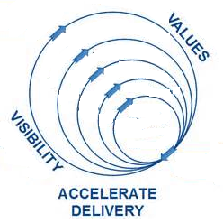
“… Make sure delivered has optimal value”
“… Determine optimal increments or frequency of delivery."
Deliver incremental value

Slide 12
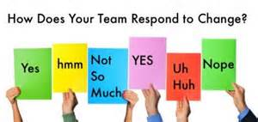
“… is ready for change and able to smoothly adapt and adjust “
“..you minimize common disruptions caused by change. “
Stay agile

Slide 13
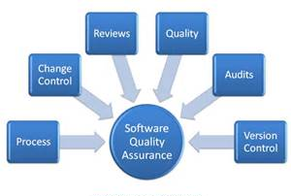
“Quality is something that must be proactively incorporated into the solution delivery lifecycle, it does not just happen.”
Invest in quality

Slide 14

“… expected to improve next time”
“…individual, project and organization wide process”
Learn from experiences

Slide 15

“…customers work closely and incrementally”
“…better meets their expectations”
“…increase the for project success “
Make Partnership with customers

Slide 16
Question and Answer

Slide 17

Day 2 Mindset

Slide 18

“While the foundational principles discussed above guide how a team should be oriented to maximize success, orienting team members as individuals to maximize their success is called a mindset.”
Mindset

Slide 19

“Singularly accountable but jointly responsible for a project”
Empowerment and accountability
Shared vision and Role and responsibilities
Foster a team of peers

Slide 20

“Everyone on a team needs to understand what customers deem valuable”
Customers need
Want and value.
Project at risk
Focus on business value

Slide 21

“As team members deliver their portions, they need to look back at the overall mission, goals, and vision for a solution”
Size and complexity
Keep the ultimate solution
Subteam optimizes their area
Keep a solution perspective

Slide 22

“Not only should a team invest in quality, but the members should also see that quality is as much their responsibility as that “
Delegated or passed
Solution delivery life cycle
Own quality and delivering the best
Continuous improvement
Pride in workmanship

Slide 23

“Given that most projects, teams, and environments are unique, each project presents opportunities to learn, experiment, and refine skills, processes, and procedures. ”
Learning and adapting
Better peers
All levels of an organization
Learn continuously

Slide 24

“Qualities of service (QoS) define expected operational characteristics of a solution”
Understand QoS
Ensure QoS
Qualities of service

Slide 25

“The viewpoint of software development, good citizenship means being trustworthy, honorable, responsible, and respectful in all aspects of your work. ”
Interact with stakeholders
Openly and willingly
Good citizens act on and are mindful
of the greater good
Practice good citizenship

Slide 26

“MSF establishes an environment in which team members and stakeholders are able to trust that their fellow team members will deliver on they say they will do.”
Checks and balances
Trust and empowerment
Interdependent activities
Deliver on your commitments

Slide 27
Question and Answer

Slide 28
Day 3 Team Model
Governance

Slide 29
“The MSF Team Model segments typical solution delivery activities and responsibilities into seven advocacy groups.”

Slide 30
Role | Goals | Functional areas
Product Management | Ensure solution delivers business value Define the solution within project constraints Ensure customers’ needs and expectations are satisfied | Marketing/Corporate Communications Business Analysis Product Planning
Program Management | Deliver the solution within project constraints Set up the means by which sponsor needs and expectations are satisfied | Project management Program Management Resource Management Process Assurance Project Quality Management Project Operations
Architecture | Design a solution to meet business goals within project constraints | Solution Architecture Technical Architecture
Development | Build the solution to specification | Solution development Technology consulting
User Experience | Maximize solution usability Enhance user readiness and effectiveness Ensure users’ needs and expectations are satisfied | Accessibility Internationalization Technical Support Communications Training Usability User Interface Design
Test | Approve solution for release only after making sure all aspects of the solution meet or exceed their respective, defined quality levels | Regression Testing Functional Testing Usability Testing System Testing
Release / Operations | Smooth deployment and transition to operations Ensure IT/Business Operations needs and expectations are satisfied | Release Management Delivery Infrastructure Operations Build Management Tool Administration
Team Model

Slide 31
“The Governance Model (formerly called the Process Model) is designed to provide the right guidance to the right people at the right time.
MSF that has been used successfully to improve project control, minimize risk, improve solution quality, and increase development speed. “
-MSDN

Slide 32
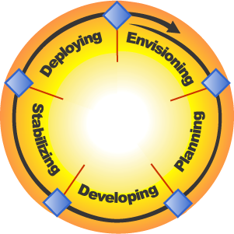
Deployment
Complete
Release Readiness
Approved
Vision/Scope Approved
MSF
Project Plans
Approved
Scope Complete
Governance

Slide 33
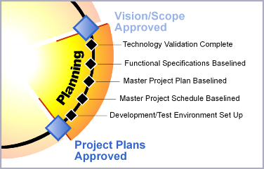
Deliverables:
Functional
specifications
Master project
plan
Master project
schedule
Planning Phase

Slide 34
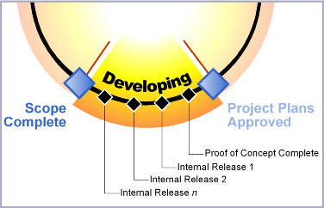
Deliverables:
Solution code
Build images
Training materials
Documentation
  Deployment processes
  Operational procedures
  Support and troubleshooting
Marketing materials
Updated master plan and schedule
Developing Phase

Slide 35
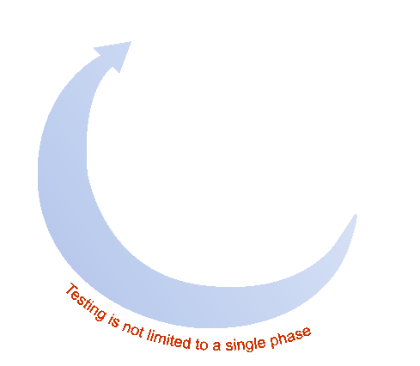
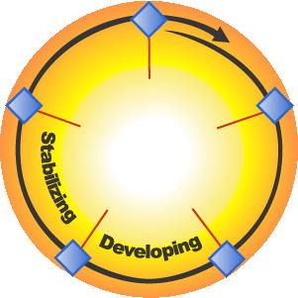
Release Readiness
Approved
MSF
Scope
Complete
Project Plans
Approved
Testing is part of the build cycle, not a standalone activity
Testing the Solution

Slide 36
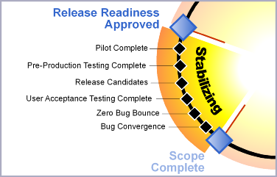
Deliverables:
Pilot review
Release-ready versions:
  Source code and
  executables
  Scripts and installation
  documentation
  End-user help and
  training materials
  Operations documentation
  Release notes
Testing and bug reports
Project documents
Stabilizing Phase

Slide 37
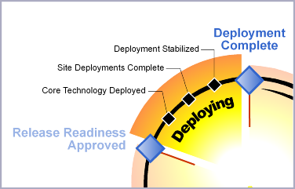
Deliverables
Operations and
support information
systems
Repository of all
versions of docs,
load sets, configs,
scripts, and code Project close-out report
Deploying Phase

Slide 38
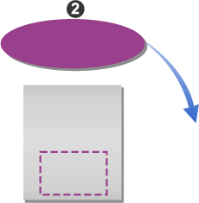

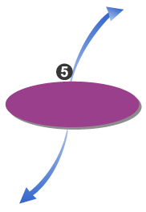
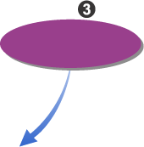
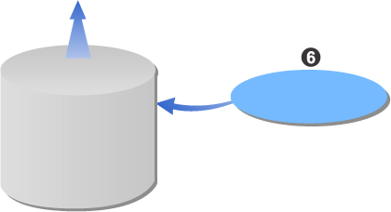
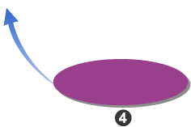
Analyze and
Prioritize
Risk
Statement
Identity
Master
Risk List
Control
Plan and
Schedule
Top n
Risks
Learn
Track and
Report
Risk
Knowledge Base,
Concepts,
and Processes
Risk Management

Slide 39
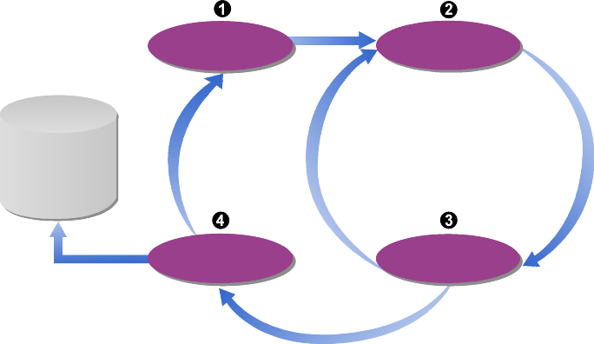
Use proactive vs.
reactive approach
Treat readiness gaps
as risks
Capture and manage
team knowledge
Focus on individual,
not organizational readiness
Remember – the need for team readiness spans the life of the project
Define
Assess
Knowledge
Skills
Abilities
Evaluate
Change
Readiness Management Discipline

Slide 40
Question and Answer

Slide 41
Thanks

